Slide 1
Generators and Data Augmentation
Przemysław Sekuła

Slide 2
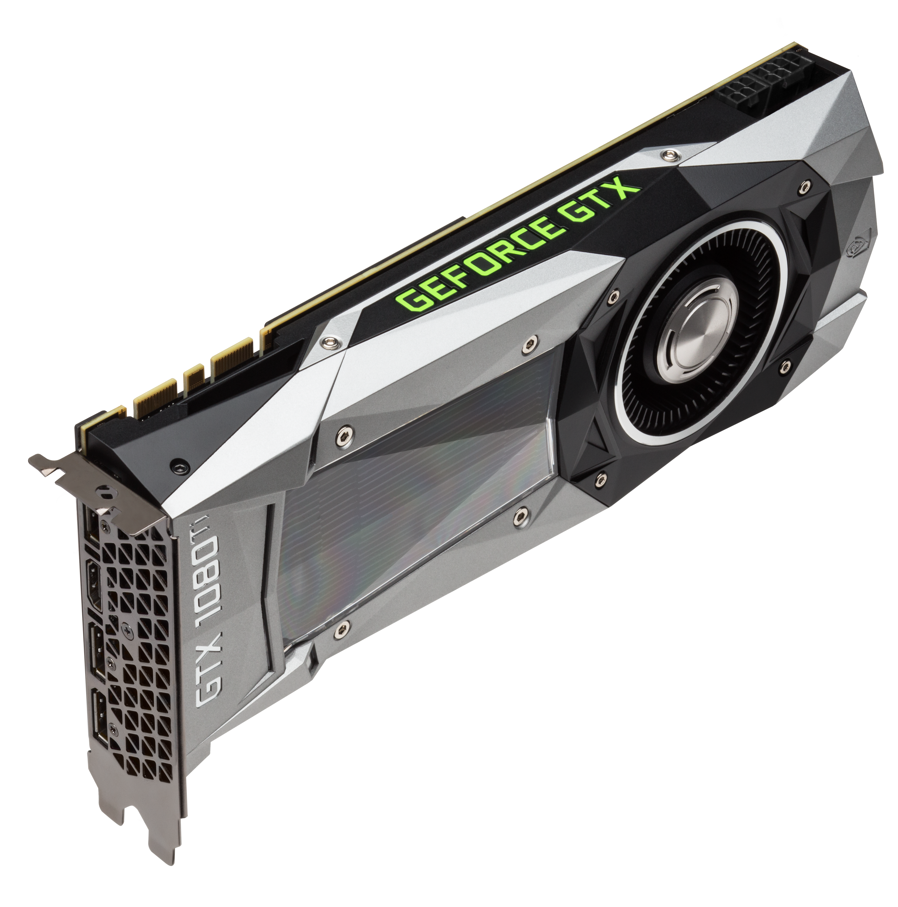
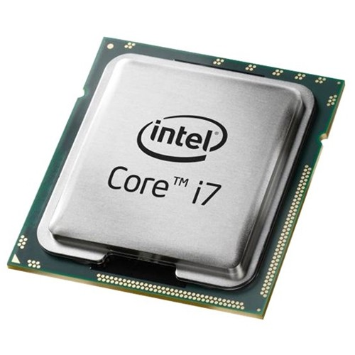
MINIBATCHES for IMAGES - Reminder
The hitherto presented approach is possible if you can fit all the data in the memory.
For big datasets (particularly for images) you often cannot do it.
If you cannot do it, you should use generators!

Slide 3
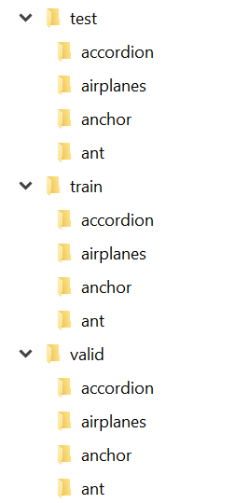
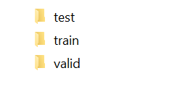
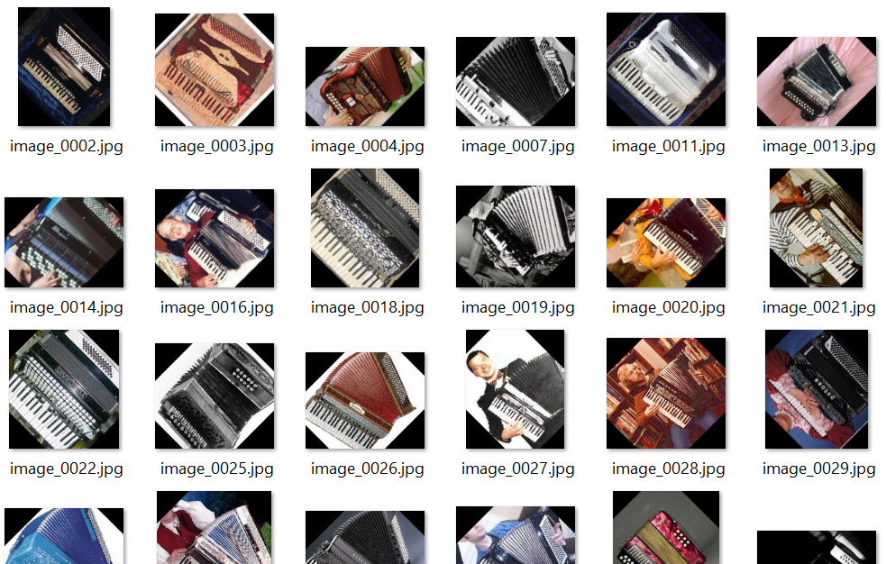
GeneratorS in KERAS – Folder Structure

Slide 4
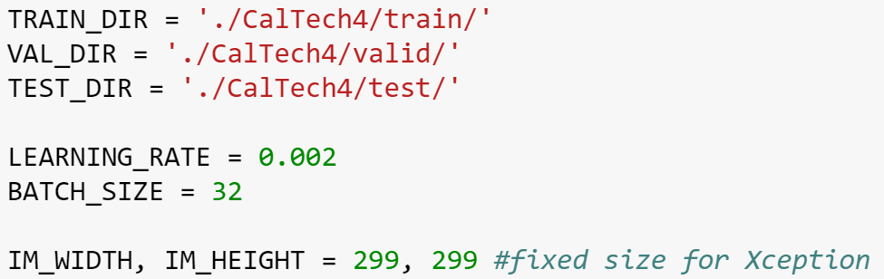
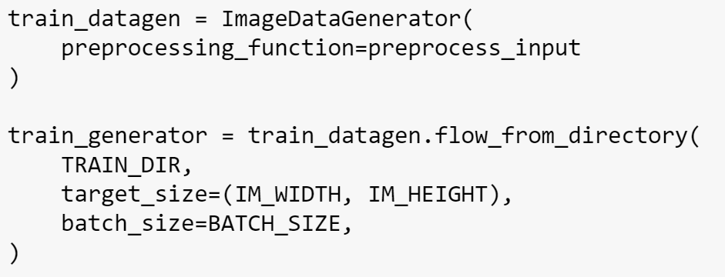
GeneratorS in KERAS

Slide 5
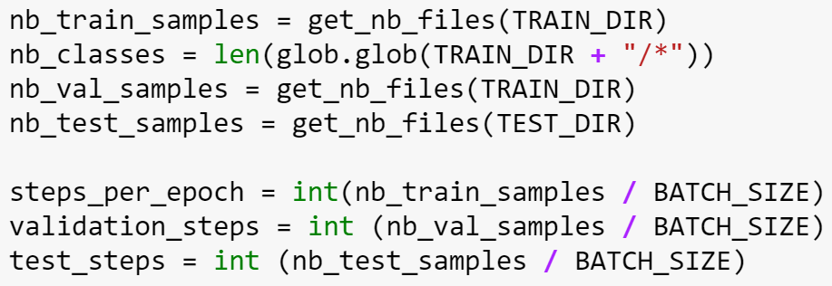
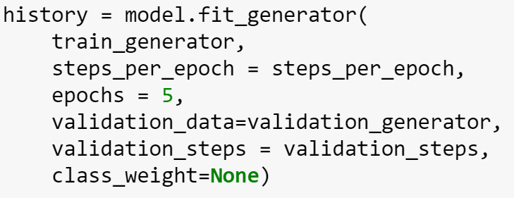
GENERATORS IN KERAS

Slide 6
Data augmentation
Deep Learning algorithms are data hungry
Usually the more data you have, the better
But preparing (labeling) more data is tedious, laborious and may cost a lot of money
One of the solutions is data augmentation
Maybe we can do something to increase the size of our dataset automatically

Slide 7
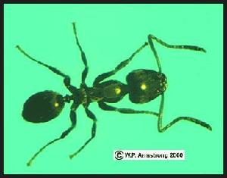
Data augmentation - Flipping

Slide 8
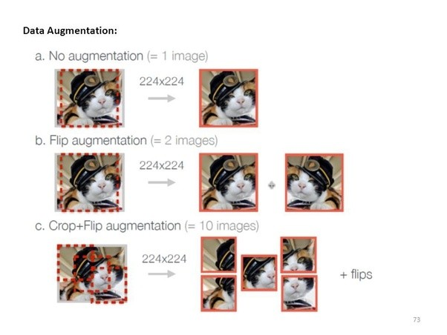
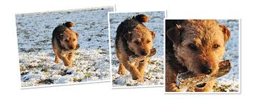
Data Augmentation - Cropping

Slide 9
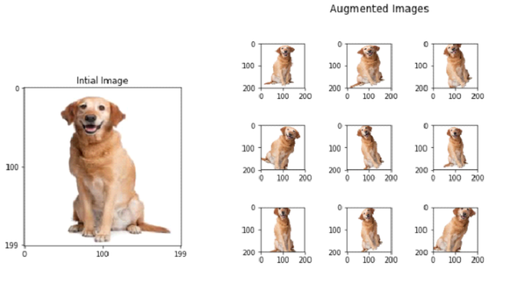
Data augmentation - Reshaping

Slide 10
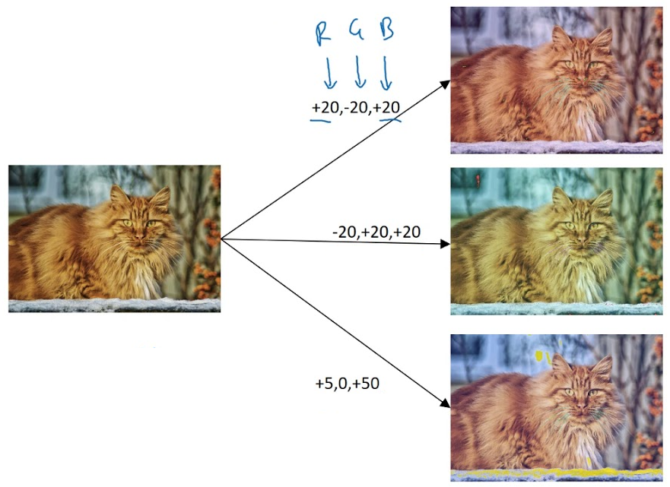
Data augmentation – Color Shifting
*Andrew Ng – Deep Learning (Coursera)

Slide 11
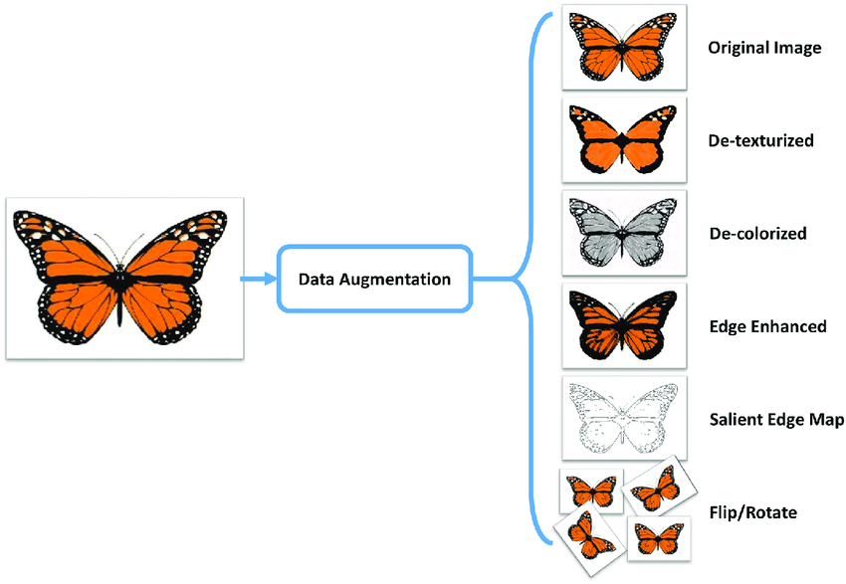
Data augmentation – Other

Slide 12
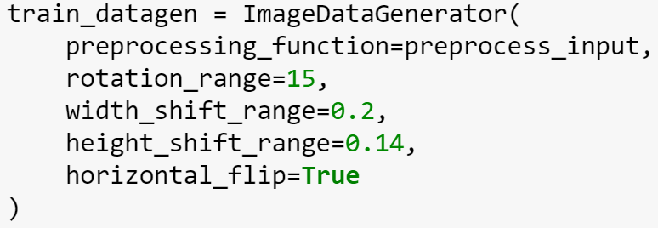
Data augmentation - Keras
https://keras.io/preprocessing/image/

Slide 13
Thank you Q & A

